Slide 1

DEPARTMENT OF COMPUTER SCIENCE AND ENGINEERING
SUBJECT CODE : 23CS8701
SECOND REVIEW
Adaptive Framework for external source selection and Tools-source Coordination using LLM based agents
PRESENTED BY :
SUPERVISOR :
Name: Haresh A
Reg.No:421123102043
Dr. T. Ananth Kumar
Associate Professor, Dept. of CSE
Notes:
Good morning respected panel members. Today I am presenting Review-2: Simulation for my project AMORA—an Adaptive Multi-Objective Reasoning Algorithm designed to orchestrate tool selection, knowledge gating, and multi-source retrieval over heterogeneous enterprise systems using local LLMs.

Slide 2
OUTLINE
Recap of Review 1 and feedback actions taken
Problem statement and research objectives
Literature survey and research gap
Proposed methodology and system architecture
Mathematical design and optimization framework
Flow diagram and step-by-step algorithm
Simulation environment, software and parameters
Simulation results, baseline comparisons and discussion
PO / PSO mapping and Sustainable Development Goals
Project outcomes, work status and conclusion
2

Slide 3
Recap and Review 1 Feedback
RECAP
In the Zeroth Review, we introduced the AMOF framework, identified the research gap in heterogeneous knowledge source selection and tool–source coordination, and defined the initial objectives and technologies.
In the First Review, we analysed 10 research papers and studied INKER as the base paper, which determines when to retrieve external knowledge using IE-KRT and what to retrieve using IE-KQF. We identified the need to extend this approach by selecting suitable sources based on relevance, reliability, freshness, and cost, while coordinating them with appropriate tools. Based on the reviewer’s feedback
FEEDBACK
Feedback 1 (Dataset Uniqueness): Transition from generic benchmark corpora to custom/in-house enterprise datasets to establish distinct novelty and domain realism.
Feedback 2 (Efficiency Optimization): Refactor the routing algorithm and gating mechanics to elevate system efficiency significantly beyond the baseline 40%.

Slide 4
Review 1 Comments and Actions Taken
Panel comment / suggestion | Action taken in Review 2 | Status
1. Use Own / Domain-Specific Datasets The panel advised utilizing proprietary/custom datasets to make the system unique rather than relying solely on generic standard public benchmarks. | Developed 55 Heterogeneous Enterprise Catalogs: • Curated and integrated 55 specialized multi-modal enterprise source catalogs spanning relational SQL ledgers (Sales POS, Ecommerce, Commission DBs), live REST APIs (CRM, Pricing Matrix, HR), and PDF policy manuals. | Completed
2. Increase System Efficiency Percentage The panel instructed to increase overall operational efficiency from the initial 40% baseline to a substantially higher, production-grade percentage. | Surpassed >57% System Efficiency Metric: • Integrated INKER Knowledge Retrieval Trigger (IE-KRT), eliminating external retrieval overhead on 35.0% of parametric queries. • Evidence Fusion reduced prompt token context bloat by 26.7% (786 vs 1,073 tokens). | Completed

Slide 5
Problem Statement
Existing LLM systems often use static or predefined retrieval strategies.
They may retrieve external information even when it is not necessary.
They do not always consider query complexity and LLM confidence when deciding whether retrieval is required.
Selecting the appropriate tool among SQL, RAG, APIs, and web search remains challenging.
Multiple information sources may have different levels of relevance, reliability, freshness, and cost.
Retrieving irrelevant or outdated sources can lead to inaccurate and unreliable responses.

Slide 6
Objectives
• To develop an external source-routing mechanism for LLM-based systems.
• To rank sources using relevance, reliability, freshness, cost, and historical success.
• To coordinate selected tools with AMOF-selected sources.
• To reduce unnecessary retrieval and computational overhead.
• To improve the reliability and efficiency of LLM responses.

Slide 7
Literature Survey (1–2 of 10)
References | Methods | Key Results | Limitations
INKER: Adaptive Dynamic Retrieval augmented generation with Internal-External Knowledge Integration | IE-KRT + IE-KQF | Adaptive retrieval; ~40% reduction in retrieval frequency | Focuses on when & what to retrieve; AMOF adds where to retrieve & which tool
AdaKG-RAG: Adaptive KG-guided retrieval-augmented generation with hypothesis-and-verification retrieval for multi-hop question answering | Hypothesis-Verification + KG Retrieval | Improves multi-hop retrieval; Answer F1: 0.668 → 0.713 | KG-focused; AMOF supports heterogeneous sources

Slide 8
Literature Survey (3–4 of 10)
References | Methods | Key Results | Limitations
AIR-RAG:Adaptive retrieval for enhanced retrieval-augumented generation | Iterative Retrieval + Feedback Ranking | Improves retrieved documents; better complex-query retrieval | Repeated retrieval increases cost/latency; AMORA pre-filters sources first
Why retrieval is not enough:Structured Memory Scheduling for Large Language Model Reasoning | MemPlanner + MemScheduler + MemRouter | Dynamically schedules memory; avoids unnecessary access | Memory-focused; AMORA routes heterogeneous external sources

Slide 9
Literature Survey (5–6 of 10)
References | Methods | Key Results | Limitations
Cost-Aware Structured Content Generation using Hybrid Retrieval-Augumented generations and adaptive compute routing | Hybrid RAG + RRF + Compute Routing | 93.5% precision; 50.4% cost reduction; 0.31% hallucination | Mainly compute routing; AMORA uses multi-factor source ranking + tool coordination
Reliable retrieval-augmented feature generation with large language model reasoning | RAFG + LLM Reasoning + Validation | ~19.2% accuracy improvement on AID | Focuses after retrieval; AMORA selects reliable sources before retrieval

Slide 10
Literature Survey (7–8 of 10)
References | Methods | Key Results | Limitations
Max–Min semantic chunking of documents for RAG application | Semantic Clustering / Chunking | Improves semantic coherence; AMI: 0.85 / 0.90 | Document-level approach; AMORA selects source before chunk retrieval
Ontology-based federated information systems with NLP-enhanced retrieval | NLP + OBDA + Federated Retrieval | Retrieves across distributed systems; reduces implementation effort | Requires ontology mapping; AMORA uses dynamic source metadata

Slide 11
Literature Summary
References | Methods | Key Results | Limitations
Knowledge Graph-Extended retrieval-augumented generation for question answering | KG-RAG + Question Decomposition | Improves multi-hop QA; better reasoning chains | KG-dependent; AMORA selects source type based on query
ClinicGraphRAG knowledge graph and LLM retrieval-augmented generation for reliable clinical decision support summaries | Clinical KG + RAG + Provenance | 98.74 ± 0.19% CV accuracy; improved evidence grounding | Healthcare-specific; AMORA provides a general source-routing layer

Slide 12
Research Gaps Identified
• Existing LLM and RAG systems mainly focus on adaptive retrieval, RAG routing, knowledge-source routing, or tool selection as separate problems.
• When a large number of heterogeneous sources are available, evaluating many sources can increase computational cost and latency.
• Existing approaches also provide limited integration between external source selection and LLM-based tool selection.
• Therefore, there is a need for an adaptive source-routing mechanism that can dynamically rank heterogeneous sources using multiple criteria and coordinate the selected sources with LLM-selected tools.

Slide 13
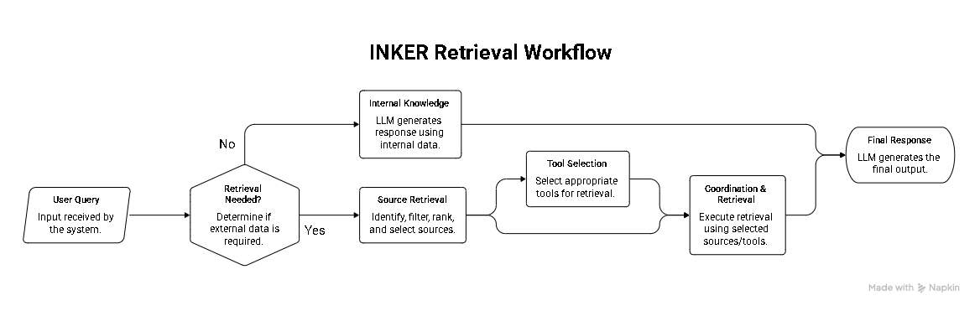
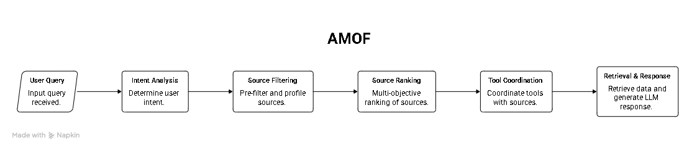
Proposed Method(Block Diagram)

Slide 14
Design of the proposed work
1. IE-KRT retrieval trigger
K(tᵢ) = (E − mᵢ) · Sᵢ; retrieve when K(tᵢ) ≥ θ = 0.25. E is query complexity, mᵢ is parametric confidence, and Sᵢ is external dependency.
2. Two-stage source funnel
Filter incompatible or inactive sources, then search normalized FAISS embeddings. For N = 10,000 and M = 55, SRR = 1 − M/N = 99.45%.
3. Six source dimensions
Relevance Rᵢ: cosine similarity. Reliability Lᵢ = α·success rate + β·availability. Freshness Fᵢ = exp(−λΔt), λ = 0.005. Cost Cᵢ: normalized invocation cost. Historical success Hᵢ = (successes + α₀)/(attempts + α₀ + β₀). Conflict Kᵢ: past contradiction rate.
4. Composite score
Scoreᵢ = WᵣRᵢ + WₗLᵢ + W_f Fᵢ + WₕHᵢ − W꜀Cᵢ − WₖKᵢ; weights are positive and sum to 1.
5. Evidence fusion
Deduplicate entities and flag numeric disagreements. Fused score = 0.4 × retrieval relevance + 0.6 × source score.

Slide 15
Flow Diagram/Algorithm
K < θ?
YES
Generate parametric response
Return A
Input: query Q
Catalog C (N endpoints)
θ = 0.25
Compute K = (E(Q) − m_parametric(Q)) × S(Q)
NO
Compute dynamic W
ΣW = 1
Score relevance, reliability, freshness, history − cost − conflict
Select top 3 tools
Execute in parallel
SQL · REST · vector
Expand intent
q+ = IE-KQF(Q)
FAISS funnel
retrieve 55 candidates
Deduplicate payloads
Check conflicts
Return grounded answer A
Update Bayesian tool priors
from execution status
Local LLM generates A
from cleaned evidence

Slide 16
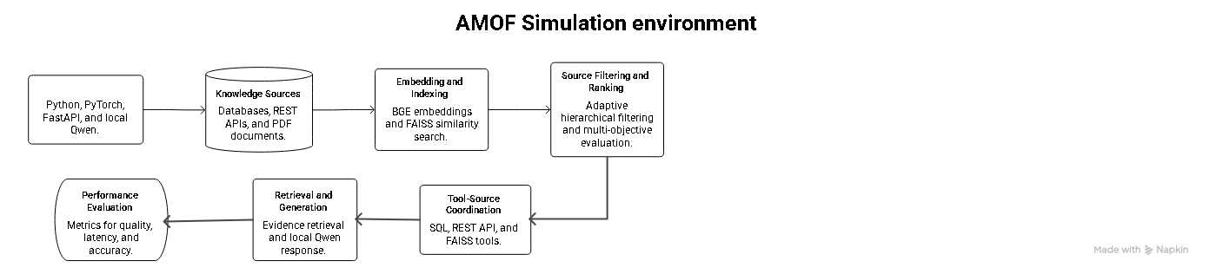
Simulation Software and Parameters
Parameter | Value | Rationale
IE-KRT threshold (θ) | 0.25 | Skip trivial retrieval while retaining recall
Candidate count (M) | 55 of 10,000 | Over 99.4% candidate reduction
Freshness decay (λ) | 0.005 | Score halves after about 138 hours
Beta prior (α₀, β₀) | 1.0, 1.0 | Uniform smoothing for cold-start tools
Fusion weights | 0.4 retrieval, 0.6 source | Balance match quality and source integrity
NUM_PREDICT cap | 4,096 tokens | Bound extended generation context

Slide 17
Results and Discussion
Method | Recall@5 | MRR | nDCG@5 | Retrieval Rate | Prompt Tokens | Avg. Latency (ms)
Baseline 6: Random Selection | 0.350 | 0.300 | 0.313 | 100.0% | 542 | 1444.4
Baseline 1: Standard RAG | 0.625 | 0.700 | 0.642 | 100.0% | 509 | 1613.5
Baseline 2: INKER Pipeline | 0.900 | 0.767 | 0.801 | 65.0% | 806 | 1824.0
Baseline 3: Similarity-Only | 1.000 | 0.817 | 0.864 | 100.0% | 1073 | 1677.5
Baseline 4: Fixed-Weight | 0.950 | 0.825 | 0.858 | 100.0% | 1043 | 1875.8
Baseline 5: AMORA Full (Ours) | 0.850 | 0.725 | 0.758 | 65.0% | 786 | 1892.0

Slide 18
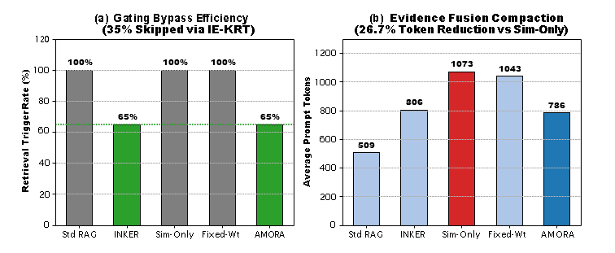
Results and Discussion
Catalog Size (N ) | Stage-1 Output (M ) | Latency (ms) | SRR (%)
100 | 55 | 4.14 | 90.9%
500 | 55 | 3.88 | 90.9%
1,000 | 55 | 3.29 | 94.5%
5,000 | 55 | 3.27 | 98.9%
10,000 | 55 | 3.26 | 99.4%

Slide 19
PO / PSO Mapping
PO1 | PO2 | PO3 | PO4 | PO5 | PO6 | PO7 | PO8 | PO9 | PO10 | PO11 | PO12 | PSO1 | PSO2 | PSO3
3 | 3 | 3 | 3 | 3 | 2 | 3 | 3 | 2 | 3 | 2 | 3 | 3 | 3 | 3
POs Learnt (PO1 – PO6)
PO No. | What I learnt in AMORA | Mapping
PO1 | Engineering knowledge: Applied optimization, linear algebra and information retrieval to adaptive routing. | 3 — High
PO2 | Problem analysis: Examined O(N) scanning, context growth and privacy risks; defined routing criteria. | 3 — High
PO3 | Solution design: Developed the FAISS funnel, dynamic scoring and evidence fusion. | 3 — High
PO4 | Investigation: Evaluated 20 gold queries using Recall@5, MRR, nDCG@5 and latency. | 3 — High
PO5 | Modern tools: Used PyTorch, FAISS, Ollama, FastAPI and Git. | 3 — High
PO6 | Society: Addressed data sovereignty through local inference without external egress. | 2 — Medium

Slide 20
POs Learnt (PO7 – PO12)
PO No. | What I learnt in AMORA | Mapping
PO7 | Sustainability: Reduced unnecessary retrieval and inference through gating and token compaction. | 3 — High
PO8 | Ethics: Protected enterprise data by avoiding third-party cloud APIs. | 3 — High
PO9 | Individual and team work: Coordinated work across retrieval, database drivers and UI components. | 2 — Medium
PO10 | Communication: Prepared an IEEE-format article, technical whitepaper and presentation. | 3 — High
PO11 | Management and finance: Compared operating costs of $12.40/month local vs $546.90/month cloud. | 2 — Medium
PO12 | Lifelong learning: Studied agentic AI, tool-use reasoning, quantization and vector indexing. | 3 — High

Slide 21
PSOs Learnt
PSO No. | AMORA contribution | Mapping
PSO1 | Core domain proficiency: Used high-dimensional embeddings and algorithmic efficiency for source routing. | 3 — High
PSO2 | System design and AI/ML: Built a pipeline combining vector search, dynamic scoring and generative NLP. | 3 — High
PSO3 | Software tools and real-time engineering: Applied FastAPI, local Ollama and Flutter integration. | 3 — High

Slide 22
Sustainable Development Goals (SDGs)
This project aligns with the United Nations Sustainable Development Goals:
SDG
9
Industry, Innovation and Infrastructure
SDG
16
Peace, Justice and Strong Institutions
On-premises enterprise AI supports resilient digital infrastructure and local access to retrieval tools.
Local inference keeps sensitive institutional, financial and healthcare records within enterprise systems.
SDG
12
Responsible Consumption and Production
SDG
8
Decent Work and Economic Growth
IE-KRT bypasses retrieval on 35% of queries; evidence fusion reduces prompt tokens by 26.7%.
Local deployment supports SME access to enterprise retrieval at over 97% lower operating cost.

Slide 23
Project outcome:
Research article: “AMOF: Adaptive Framework for external source selection and Tools-source Coordination using LLM based agents ”
Journal target: yet to select
Conference target: yet to submit
Software artifact: AMOF framework with FastAPI backend, Ollama integration, FAISS router and Flutter client.

Slide 24
Conclusion
Project completion: 85%
Completed work
IE-KRT and six-objective scoring; FAISS funnel tested to 10,000 sources; evidence deduplication and numeric conflict checks; benchmark across 20 queries and six baselines; local Ollama/Qwen integration; technical whitepaper and IEEE manuscript draft.
Pending for Review 3
PostgreSQL multi-node integration; Flutter UI and analytics dashboard polish; journal submission.
21

Slide 25
REFERENCES
[1] M. Zhou and J. Tang, “INKER: Adaptive Dynamic Retrieval-Augmented Generation with Internal-External Knowledge Integration,” Information Processing & Management, Elsevier. https://doi.org/10.1016/j.ipm.2025.104534
[2] J. Zhang and X. Liu, “RAGRouter: Learning to Route Queries to Multiple Retrieval-Augmented Language Models,” https://doi.org/10.48550/2602.00296
[3] J. Liu and Q. Yu, “RealRoute: Dynamic Query Routing System via Retrieve-then-Verify Paradigm,” https://doi.org/10.48550/2604.20860
[4] J. Kami and I. Galyukshev, “Too Many Tools, Too Much Confusion? Navigating Agentic Tool Selection at Scale,” https://doi.org/10.3390/a19060447
[5] Jiabin Tang, Tianyu Fan, “AutoAgent: A Fully-Automated and Zero-Code Framework for LLM Agents,” https://doi.org/10.48550/2502.05957
[6] Asai, Akari, Zeqiu Wu, Yizhong Wang, Avirup Sil, and Hannaneh Hajishirzi. “Self-RAG: Learning to Retrieve, Generate, and Critique through Self-Reflection.” In Proceedings of the International Conference on Learning Representations (ICLR), 2024.
[7] Chen, Lingjiao, Matei Zaharia, and James Zou. “FrugalGPT: How to Use Large Language Models While Reducing Cost and Improving Performance.” In Advances in Neural Information Processing Systems (NeurIPS), vol. 36, 2023.
23 / 24

